Slide 1
Capstone Engagement
Assessment, Analysis, and Hardening of a Vulnerable System

Slide 2
Table of Contents
This document contains the following sections:
01
Network Topology
02
Red Team: Security Assessment
03
Blue Team: Log Analysis and Attack Characterization
Hardening: Proposed Alarms and Mitigation Strategies
04

Slide 3
Network Topology
‹#›

Slide 4
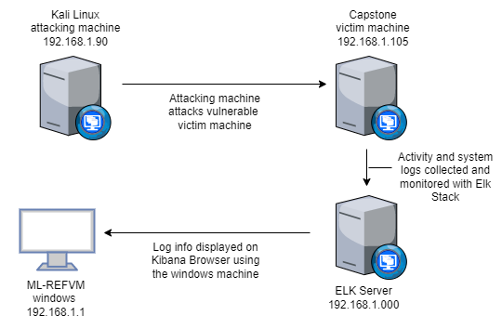
Network Topology
Network
Address Range:192.168.1.0/24
Netmask:255.255.255.0
Gateway:192.168.1.1
Machines
IPv4: 192.168.1.90
OS: Linux
Hostname: Kali
IPv4: 192.168.1.105
OS: Windows
Hostname: Capstone
IPv4: 192.168.1.100
OS: Linux
Hostname: Elk
IPv4: 192.168.1.1
OS: Windows
Hostname: ML-REFVM

Slide 5

Red Team
Security Assessment
‹#›

Slide 6
Recon: Describing the Target
Nmap identified the following hosts on the network:
Hostname | IP Address | Role on Network
Kali Linux | 192.168.1.90 | Attack Machine
Capstone | 192.168.1.105 | Victim Machine
Elk Sever | 192.168.1.100 | Collect and Monitor logs
Red vs Blue ML-REFVM | 192.168.1.1 | Virtual Host Machine, used to view log data in a browser

Slide 7
Vulnerability Assessment
The assessment uncovered the following critical vulnerabilities in the target:
Vulnerability | Description | Impact
Open unfiltered ports 80 CVE-2019-6579 | Open and unsecured ports allow attackers to access directories and enable exploition of vulnerabilites. | This allowed the Red team to find sensative private information included in publicly accessable files on port 80
cve-2022-21907 CWE-98 CWE-23: Relative Path Traversal Directory indexing CWE-548 | Improper Control allows directory traversal and Remote Code Execution and information leaking through directory listings. | This allowed Red team to locate the secret_folder and upload a php reverse shell script.
Brute Force Password CVE-2019-3747 | Simple passwords can be easy to guess using a brute force wordlist tool | This allowed the Red team to brute force Ashton’s password, (Leopoldo) and access the secret files.
Hashed Password | Simple hashes can be cracked online or with tools like John the Ripper, hashcat, and others; especially if not salted. | This allowed the Red team to use md5cracker to solve the password for Ryan as linux4u.

Slide 8
Vulnerability Assessment
The assessment uncovered the following critical vulnerabilities in the target:
Vulnerability | Description | Impact
WebDav Vulnerability | Exploitation of an improperly configured server allows for access, and use of malicious scripts. | If WebDav is not configured properly, it can lead to remotely modified content.
User’s credentials found when logging CVE-2020-24227 | Storing a username/password in plain text not encrypted. | Aston had Ryan’s name and password hash stored on a public facing web site, allowing for further penetration.

Slide 9
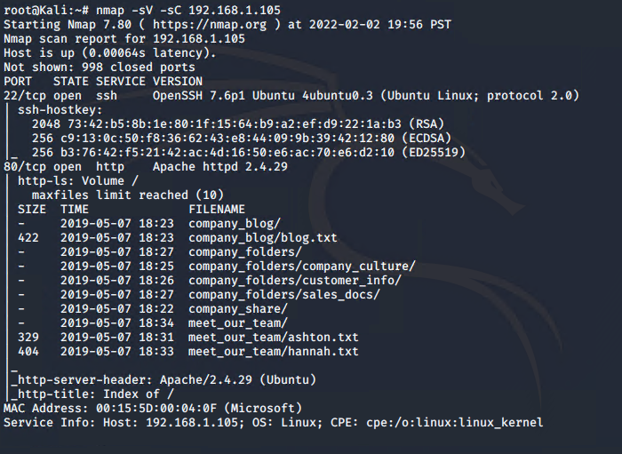
Exploitation: Port Scanning using Nmap
01
03
Tools & Processes
Nmap was used to scan for open ports and services
02
Achievements
Ip address 192.168.1.105 had an open port 22 and 80, allowing access to the directories.

Slide 10
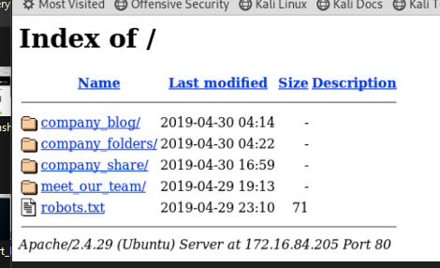
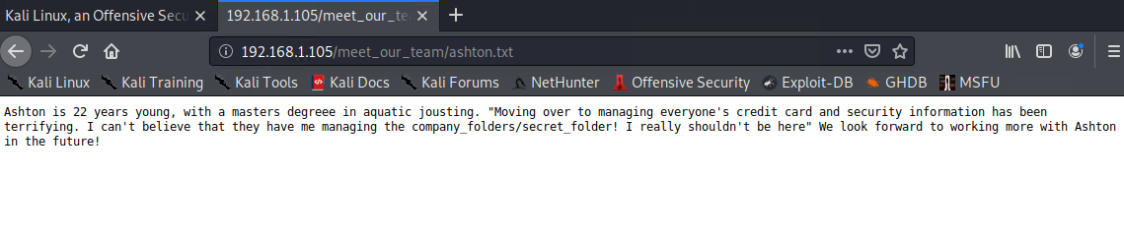
Exploitation: Accessible Files and Directories
01
Tools & Processes
Browsing the open port 80, we were able to read files in every directory.
03
02
Achievements
Here we have access to a file with directions to the secret file location. Ashton.txt

Slide 11
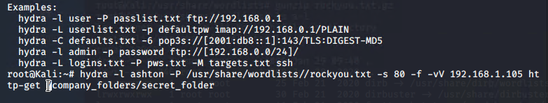
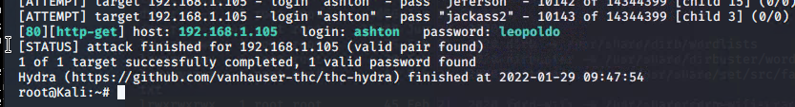
Exploitation: Brute Force Password
Achievements
The exploit confirmed username ‘ashton’ and provided the password ‘leopoldo’.
01
Tools & Processes
Using hydra and a wordlist we brute force Ashton’s password.
02
03

Slide 12
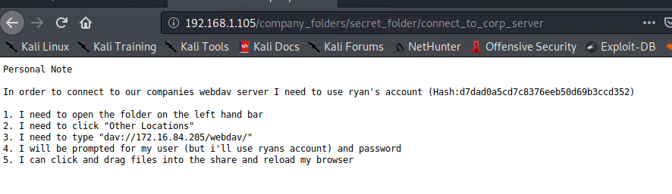
Exploitation: Brute Force Password
Tools & Processes
Ashton’s credentials provided additional instructions to connect to the WebDav server.
Achievements
Logged on to view contents of secret-folder/connect_to_corp_server where we found ryan’s hash
01
02
03

Slide 13
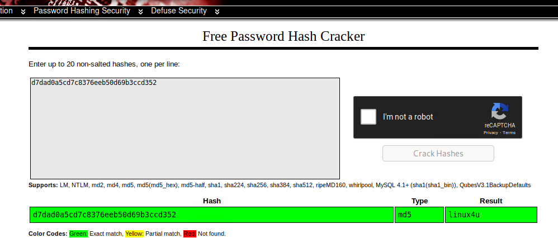
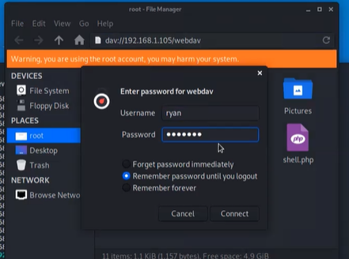
Exploitation: Hashed Passwords
Tools & Processes
Paste the hash on available websites like crackstation.net to get reverse hashed password.
03
01
Achievements
Using Ryan’s usernamae and password of linux4u will grant access to the /webdav folder.
02

Slide 14
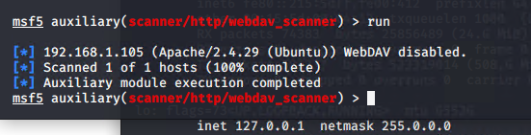
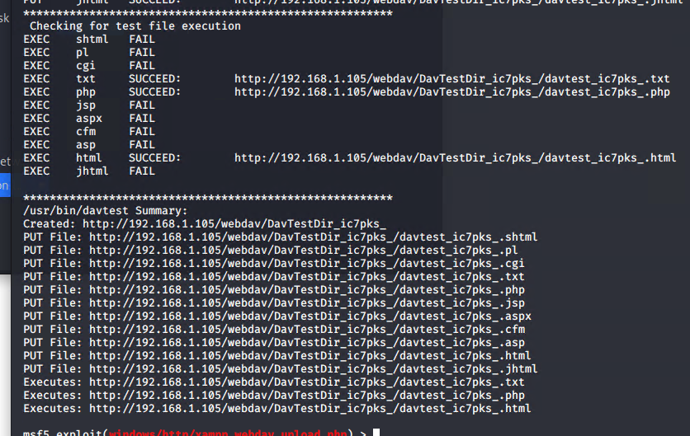
Exploitation: LFI exploit
Tools & Processes
Use msfvenom and meterpreter to deliver a payload and establish a reverse shell
03
01
Achievements
Shows server is suceptable to malicious file uploads. Attaker can now execute php script.
02

Slide 15
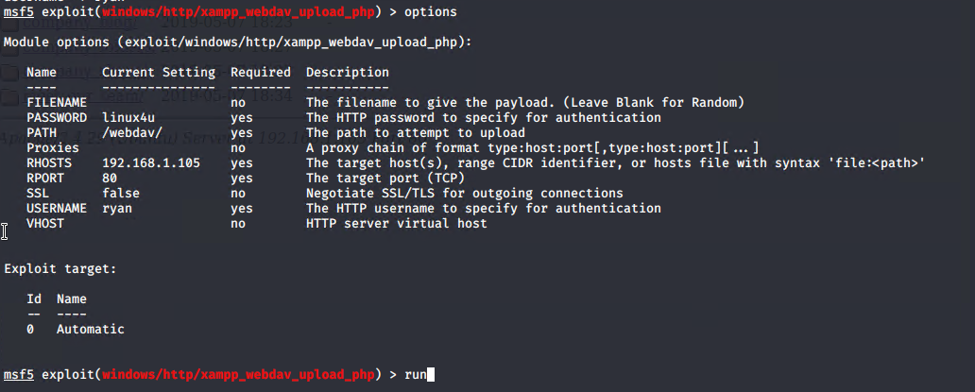
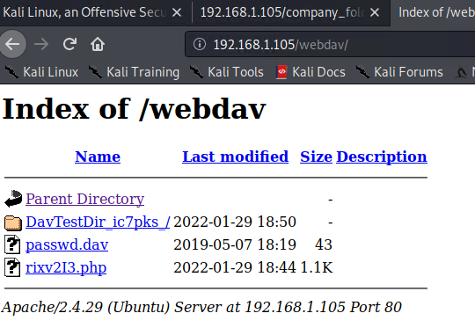
Exploitation: LFI exploit
Tools & Processes
Use msfvenom and meterpreter to deliver a payload and establish a reverse shell
03
01
Achievements
Using msfconsole with Ryan’s usernamae and password of linux4u will grant access to the /webdav folder and upload a php script.
02

Slide 16
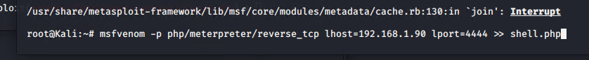
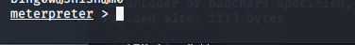
Exploitation: LFI exploit
Tools & Processes
Use msfvenom and meterpreter to deliver a payload and establish a reverse shell
set listener: mfsconsole use exploit/multi/handler
set payload php/meterpreter/reverse_tcp
Achievements
With the shell script in place, use msfvenom to set up the listening port. Allows directory transversal for attacker to discover additional information.
01
02
03

Slide 17

Blue Team
Log Analysis and Attack Characterization
‹#›

Slide 18

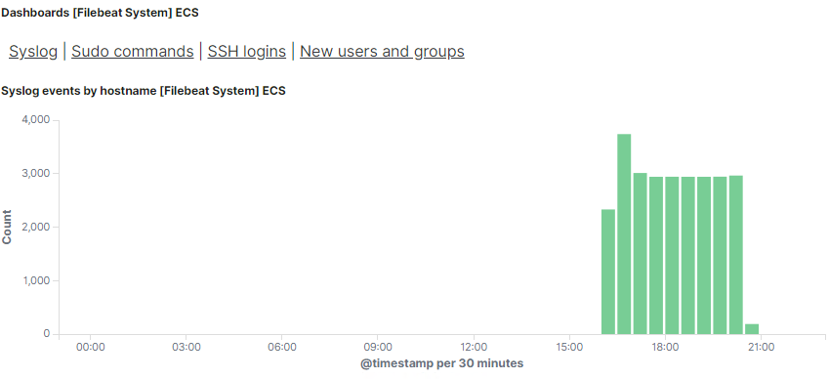
Analysis: Identifying the Port Scan
The port scan began on January 29, 2022, at approximately 1720.
Close to 4000 connections occurred, seen above an average baseline of around 2800.
The peak in traffic indicates the port scan and can be filter on with the User Agent as NMAP Scripting Engine.

Slide 19
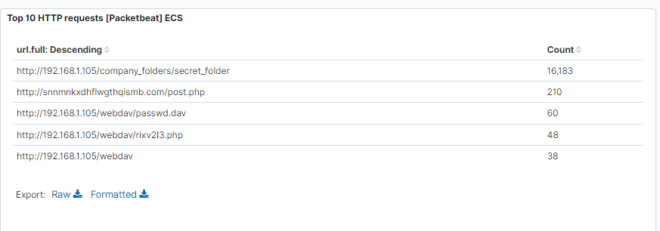
Analysis: Finding the Request for the Hidden Directory
The time the request occur was around 18:22.
16,183 requests to the /company_folders/secret_folder.
Connection to the dav server yielded finding Ryan’s hash (username and password)

Slide 20
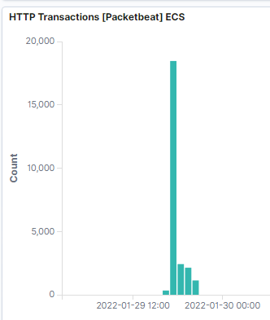
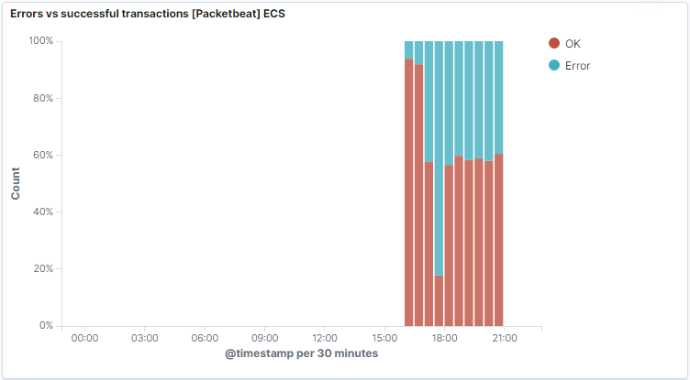
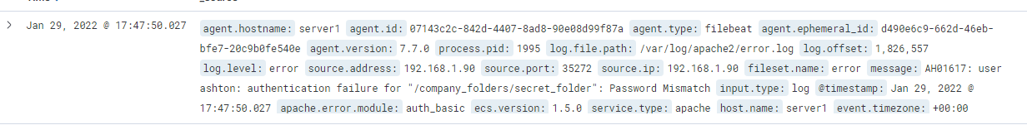
Analysis: Uncovering the Brute Force Attack
The baseline hovers approximately around 2500.
16183 request were made before the attacker discovered the password.

Slide 21
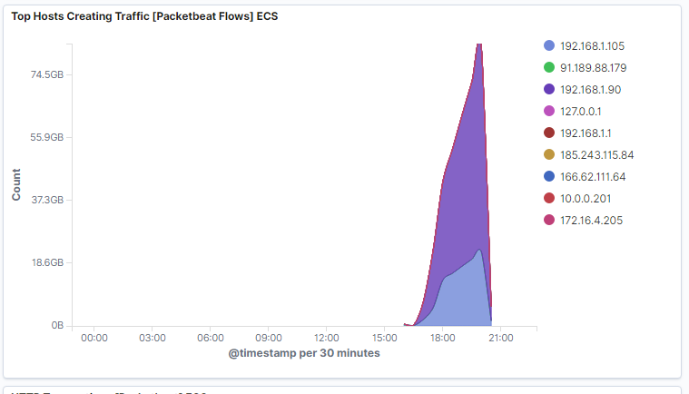
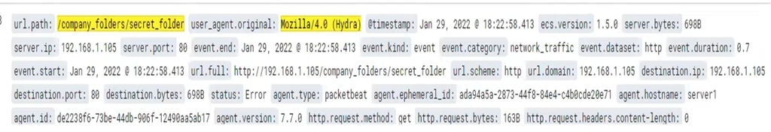
Analysis: Uncovering the Brute Force Attack
The time the request occur was around 18:22.
16,183 requests were made; originating from 192.168.1.90.
Connection to the dav server revealed Ryan’s hash (username and password)

Slide 22
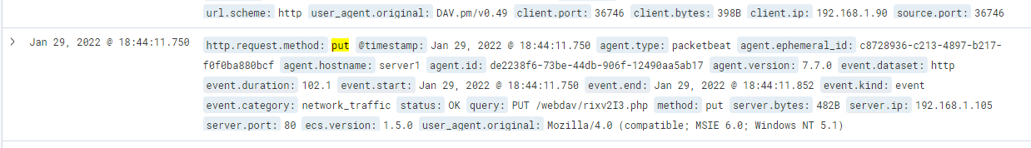
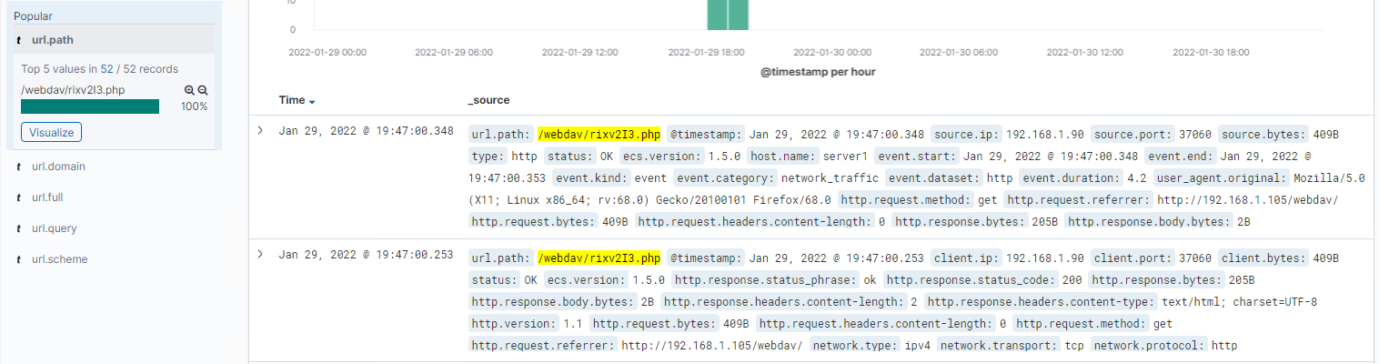
Analysis: Finding the WebDAV Connection
38 requests were made to /webdav/ passwd.dav and 52 requests to rlxv213.php. A put command around 18:44 and a use of the connection continueing to at least 19:42.
Using Ryan’s credentials, we can upload a php script to open a reverse shell.

Slide 23
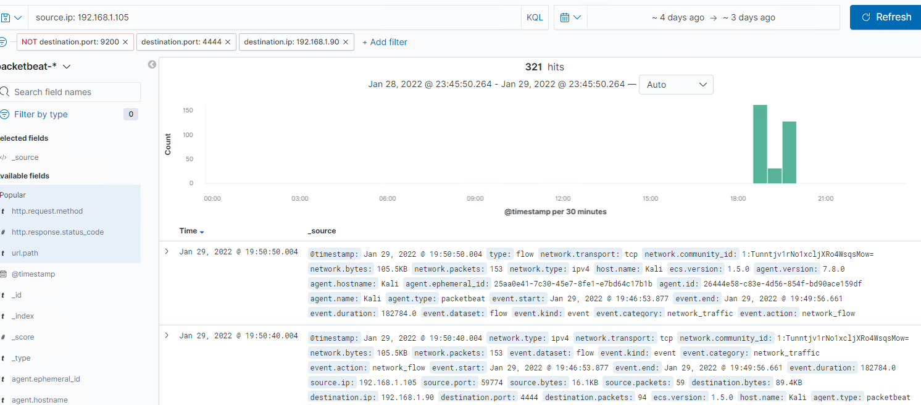
Analysis: Finding the Reverse Shell Connection
Out back to a destination IP 192.168.1.90.
Over a known used port 4444.

Slide 24
Blue Team
Proposed Alarms and Mitigation Strategies
‹#›

Slide 25
Mitigation: Blocking the Port Scan
Traffic containing Nmap or other port scans
More than 10 ports scanned in a minute or 10 consecutive (ICMP) requests.
Alarm when concurrent connections (ICMP) exceed 100 in an hour.
If a single IP address with a User Agent Nmap (for example) or any other suspicious User Agents attempts to access more than 3 ports within 30 minutes.
Configure firewall IDS to block IP that scans more than 3 ports
Close non-essential ports (allow 80 and 443)
Filter port to not respond to ICMP
Firewalls and IDSs can defend against Nmap. Possible defenses include blocking the probes, restricting information returned, slowing down the Nmap scan, and returning misleading information.

Slide 26
Mitigation: Finding the Request for the Hidden Directory
Detect access to this directory or file.
There is an excessive or abnormal amount of traffic to the hidden directory.
An unknown IP or device accesses the directory.
Alert when any unknown IP or device attempts to access the folder. Alarm threshold of 5 attempts within an hour.
Alert when there is a sudden increase of requests and traffic to the hidden folder.
Remove web access to the file.
Move file from the web server.
Restrict method of access to confidential file.
Turn off directory listing in Apache “indexes”
Create / add a deny list of IPs and devices (if needed) to firewall or IDS.
Encrypt data at rest.
Obfuscate naming conventions for sensitive/private/company critical data.

Slide 27
Mitigation: Preventing Brute Force Attacks
“401’ unauthorized number of times in so many minutes
‘user_agent.original’ value contains ‘hydra’
There is an excess or abnormal amount of traffic from a single IP or device.
Create an alert/email for 3 or more unsuccessful logins in a 10-minute time frame.
Create and alert for a sudden increase of traffic from a single IP or device outside of the trusted list.
Create an alert based on the signature ‘user_agent.original’ value that includes ‘Hydra’ in the name.
Use Captcha.
Initiate multiple logon failure lockout.
Use stronger more complex passwords
Security response for multiple failures
Set a lockout message and a re-direct to a login help page.
Freeze that user account for a period of time after failed login attempts. Account locked after 3 failed attempts within 10 minutes.

Slide 28
Mitigation: Detecting the WebDAV Connection
Create a whitelist/blacklist of IP addresses.
Note the number of times the Webdav directory is requested from IPs
Set an alert email and log when requests are made on protected files and folders from IPs.
Connections to the shared folder not accessible from the web interface.
Connections could be restricted by machine with firewall rule.
Remove the folder from the webdav web server.

Slide 29
Mitigation: Identifying Reverse Shell Uploads
Set an alarm for traffic moving over Port ‘4444’
Set a filter for filetype to detect executable files (.php) that are uploaded.
Set up IDS detection for new port/machine outbound connection.
Filter alarm for “put” method for non-trusted Ips.
Set an alert email and log when “put” requests methods are made on non-protected folders /Webdav, from non-trusted IPs. The threshold for the alert set to one or meore attempts are made.
Remove the upload ability from the web interface
Define valid types of files that the users should be allowed to upload.
Add a rule to block traffic to default ports of tools like meterpreter.

